Slide 1


SAP Cloud Integration
Training
ON THE
SAP BUSINESS TECHNOLOGY PLATFORM
Date: Jan 17th, 2023
Time: 9:00AM IST
Facilitator: Anu
www.anubhavtrainings.com

Slide 2
Agenda
Content Modifier
Multicast
Router
Mapping

Slide 3
Content Modifier
You use the content modifier step to modify the content of incoming message by providing additional information in the header or body of the message.

Slide 4
The Content Modifier allows you to modify a message by changing the content of the data containers that are involved
in message processing (message header, message body, or message exchange). Depending on which container you want to modify
, select one of the tabs Message Header, Message Body, or Exchange Property. If modifying the Message Body, you can enter
the data you want to add to the message body in an editor. If modifying the Message Header or the Exchange Property,
you can define how to access the content of the incoming message (which is then used to change the selected data container).
For example, in the Source Type, select XPath to specify an XPath expression
that addresses a particular element in the incoming message, which will be used to change the message header

Slide 5
Procedure
If the Content Modifier step is present in the integration flow, select it to edit the properties.
If you want to add Content Modifier step to the integration flow, perform the following substeps:
In the palette, choose  (Message Transformers)and then choose  (Content Modifier).
Place Content Modifier step in the integration process.
Go to the Message Header tab or choose Exchange Property (depending on whether you want to modify a message header or write data to the exchange property).

Slide 6
Choose Add to define a new entry.
Specify and define the parameters of the entry as shown below

Slide 7
Content Modifier Attributes for Message Header or Exchange Property
Attribute | Description
Action | You can specify whether the Content Modifier should create or delete the header or property defined by the table row. You must specify the name of the header or property you want to delete.
Name | Name under which the specified data has to be stored in the selected header or property data container.
Source Type | Indicates the kind of data you want to use to change the content of the selected header or property data container. You can select from the following types: Constant Allows you to write a constant value to the header or property data container. Special characters like {} and [] are not allowed. Header Allows you to specify the name of a Camel header. You can then use this header to dynamically define properties in subsequent steps. For example, if you specify the header name CamelSplitIndex, the Camel header of the same name, which counts the actual number of splits in a message split scenario, is accessed from the incoming message. In a subsequent step, you use the following expression to refer to this header (for dynamic configuration): ${header.CamelSplitIndex}. To enter a header, select header in the Type column and in the Value column choose Select to browse for predefined headers.

Slide 8
Source Type | Indicates the kind of data you want to use to change the content of the selected header or property data container. You can select from the following types: Constant Allows you to write a constant value to the header or property data container. Special characters like {} and [] are not allowed. Header Allows you to specify the name of a Camel header. You can then use this header to dynamically define properties in subsequent steps. For example, if you specify the header name CamelSplitIndex, the Camel header of the same name, which counts the actual number of splits in a message split scenario, is accessed from the incoming message. In a subsequent step, you use the following expression to refer to this header (for dynamic configuration): ${header.CamelSplitIndex}. To enter a header, select header in the Type column and in the Value column choose Select to browse for predefined headers.

Slide 9
XPath
Allows you to retrieve data from the incoming message using XML Path Language (XPath). For example, if you have selected this type, you can specify the following Value to point to an element customerName in the incoming message: /Order/Customer/CustomerNumber.
To enter XPath, select XPath in the Type column and in the Value column choose Select to browse for predefined xpath listed in wsdl of SOAP adapter for the sender.

Slide 10
Expression
Allows you to enter a Camel Simple Expression Language expression (see http://camel.apache.org/simple.htmlInformation published on non-SAP site).
For example, you can use the expression ${exchangeId} to add the exchange ID (a unique identifier of the message exchange) to a data container.
For more information on using Simple Expression Language, see Using Camel Simple Expression Language.
Property
Allows you to specify an exchange property.
To enter a property, select property in the Type column and define a value based on the selected value type

Slide 11
External Parameter
This option is not available in WebUI but for compatibility reasons we still support content using this field.
Integration developer can use externalization and externalize any type of headers or exchange properties.
Please refer to Externalize Parameters of an Integration Flow for more details.
Local Variable
Allows you to define a local variable and write its value at runtime to the header or property data container. The value can then be evaluated in subsequent steps of the integration flow.

Slide 12
Number Range
Allows you to retrieve the value (a unique identifier) of a predefined number range.
Example
If you want to increase the value in the message header define the name of the Number Range.
If you do not want to increase the value in the message header, then define the value as <name of the Number Range>:${header.headername} or <name of the Number Range>:<correlation ID>.
Note
Make sure you use the same correlation ID for all future processing.
For more information on adding number range, see Managing Number Ranges.
Global Variable
Allows you to define a global variable and to write its value at runtime to the header or property data container.
A global variable can be used across different integration flows of the same tenant.

Slide 13
Source Value | Value of the property
Data Type | Valid Java data type The Data Type column is used only for the types XPath and Expression. The data type can belong to any Java class. For example, if you are addressing a string-type element, enter java.lang.String as the Java data type. For more information about supported data types, see https://camel.apache.org/components/latest/languages/simple-language.html. If the XPath contains a namespace prefix, specify the association between the namespace and the prefix on the Runtime Configuration tab page of the integration flow Properties view. To enter an XPath, select XPath in the Type column and browse for an XPath from the lookup in the Value column.

Slide 14
Default Value (Only relevant if you have selected Local Variable or Global Variable as Type) | If you have selected Local Variable or Global Variable as Type, the value specified as Default will be assigned to the header

Slide 15
Go to the Message Body tab, and define the fields as shown below.
Save or deploy the changes.
Note
If you add a Content Modifier step without a header, body, and property, you cannot trace the element.
The Data Type column is used for the XPath type. The data type can belong to any Java class. An example of a data type for an XPath is java.lang.String.
Example
Let us assume that the incoming message contains the following information content:
<product> <productId>HT-1051</productId> <productName>Deskjet Mobile</productName> </product>
Attribute | Description
Type | The default value is Expression. If the payload contains expressions within it, then set the type as Expression; if the payload is huge and it has no expressions within it, then it is recommended to use the type Constant.
Body | Enter the content expected in the outgoing message.Remember Ensure that you set a placeholder for the existing header information.

Slide 16
Parameter | Value
Name | timestamp
Type | Expression
Data Type | java.lang.String
Value | ${date:now:yyyy-MM-dd HH:mm:ss}
The message contains information about an individual product from a product catalog.
The use case is that this message is to be enriched with the actual system time (as order time) and transferred into an order message.
In a first content modifier, specify the following settings in the Exchange Property tab:
Using the expression ${date:now:yyyy-MM-dd HH:mm:ss}, at runtime the actual system time is retrieved from the system.
The content modifier stores the time value in the timestamp property.
In a 2nd content modifier, enter the following expression in the Message Body tab:
<order> <time>${property.timestamp}</time> ${in.body} </order>

Slide 17
At runtime, the expression ${property.timestamp} dynamically retrieves the timestamp stored in the previous content modifier.
The expression ${in.body} is replaced by the actual content of the inbound message.
As a result, the final message (after the 2 content modifiers) has the following content for our example:
<order> <time>2021-05-19 09:20:56</time> <product> <productId>HT-1051</productId> <productName>Deskjet Mobile</productName> </product> </order>

Slide 18
Content Modifier Basics
To interpret an integration flow model at runtime, it is transformed into an XML structure that is compatible with Apache Camel (http://camel.apache.orgInformation published on non-SAP site), an Open Source integration framework for Java that supports the mediation and routing of messages of any format.
The only prerequisite for a message that is to be processed by the Camel framework is that it comprises the following elements:
Headers
Contain information related to the message, for example, information for addressing the message sender.
Attachments
Contain optional data that is to be attached to the message.
Body
Contains the payload (usually with the business-related data) to be transferred in the message..

Slide 19
Simple language expression
${body}
${property.name}
${header.name}

Slide 20
You can use the Content Modifier step to modify a message by adding additional data to it.
More precisely, this step type allows you to modify the content of the following three data containers during message processing:
Message Header
You can add headers to the message, and edit and delete headers.
Message Body
You can modify the message body part.
Exchange Property
You can write data to the message exchange, and edit and delete the properties.

Slide 21
Example
The following example shows how to modify both the header and body data container of a message using the Content Modifier step.
Suppose that the incoming message has the following information:
<order> <book> <BookID>A1000</BookID> <Count>5</Count> </book> </order>
On the Message Header tab of the Content Modifier, enter the following to write constant values to the message header:
Action | Name | Source Type | Source Value
Create | vendor | constant | ABC Corp
Create | delivery date | constant | 25062013

Slide 22
On the Body tab, keep placeholders for the header information specified in the first Content Modifier step (${header.vendor} and ${header.date}) to modify the content as shown below. Additionally, use a placeholder ${in.body} for the incoming message.
<invoice>
<vendor>${header.vendor}</vendor>
${in.body}
<deliverydate>${header.delivery date}</delivery>
</invoice>

Slide 23
The output message would look like this:
<invoice>
<vendor>ABC Corp</vendor>
<order>
<book>
<BookID>A1000</BookID>
<Count>5</Count>
</book>
</order>
<deliverydate>25062013</deliverydate>
</invoice>

Slide 24
Simple Expression | Output Value
${date:now:yyyyMMdd’T’hh:mm:ss} | 20211201T03:34:48
${date:now:yyyyMMdd} | 20211201
${date:now:yyyyMMdd HH:mm:ss} | 20211201 15:34:48
${date:now:yyyyMMdd HH:mm:ss.Sz} | 20211201 15:34:48.54UTC
${date:now:yyyyMMdd’T’HH:mm:ss.SSS Z} | 20211201T15:34:48.054 +0000
${date:now:yyyyMMdd HH:mm:ss.SSS aaa} | 20211201 15:34:48.054 PM

Slide 25
Function | Description
${body.substring(8,14)} | gets substring from given input data
${header.title.toUpperCase()} | Converts the data into uppercase
${body.length()} | gets the length of the body
${body.replaceFirst(‘S’,’K’)} | Replaces first occurances of letter in input data
${body.replaceAll(‘\\’,’\+’)} | Replaces all the occurance of matching data
${body.contains(“Sriprasad”)} | returns true if data exist
${body.trim()} | removes the whitespaces from start and end of the given string

Slide 26
Multicast
Define Multicast
Context
You can use the Multicast step to send copies of the same message to multiple routes. You can send copies to all routes at once using Parallel Multicast or in an order of your choice using Sequential Multicast. This allows you to perform multiple operations on the same message in a single integration process. Without Multicast, you needed multiple integration processes to perform this task.

Slide 27
Procedure
In the palette, choose  (Message Routing), then Multicast.
Choose Parallel Multicast or Sequential Multicast based on your requirement and place the step inside the integration process. Define the message paths based on the scenario.
Based on the order in which you define the message path, the system assigns names to each message route branch as Branch 1, Branch 2, and so on.
If you want to specify a name for this step, enter the value in Name field.
If you are using Parallel Multicast, no further configuration is required for the multicast step.
If you are using Sequential Multicast, you can change the order in which the message should be sent to the Sequential Multicast branches:
Choose Routing Sequence.
Select the branch which you want to move up or down in the order.
Use Move Up and Move Down buttons to change the order.
The branch name is dependent on the order in which you have defined the message path. If you change the order, the branch name will not change.
Save or deploy the configuration.

Slide 28
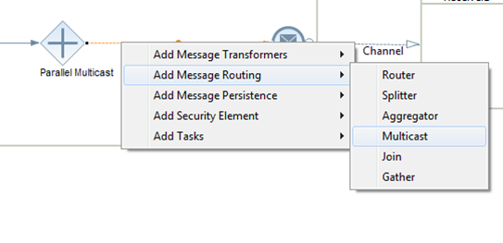
Multicast
The Multicast is represented as a decision icon, or more accurately called as the parallel gateway in BPMN lingo. You can insert the flowstep as shown below:
There are two variants of the Multicast:
Parallel Gateway: All branches of the gateway are executed in parallel.
Sequence Gateway: Branches are executed in the order specified in the Properties tab.

Slide 29
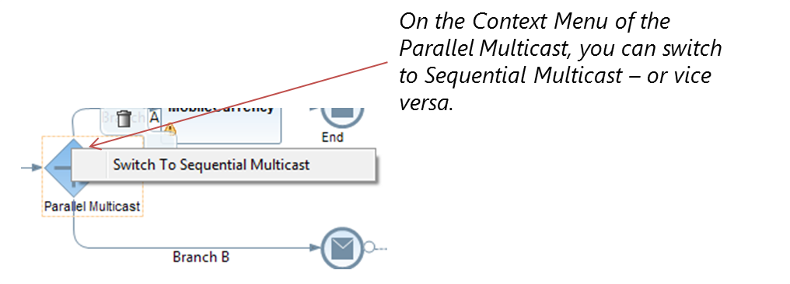
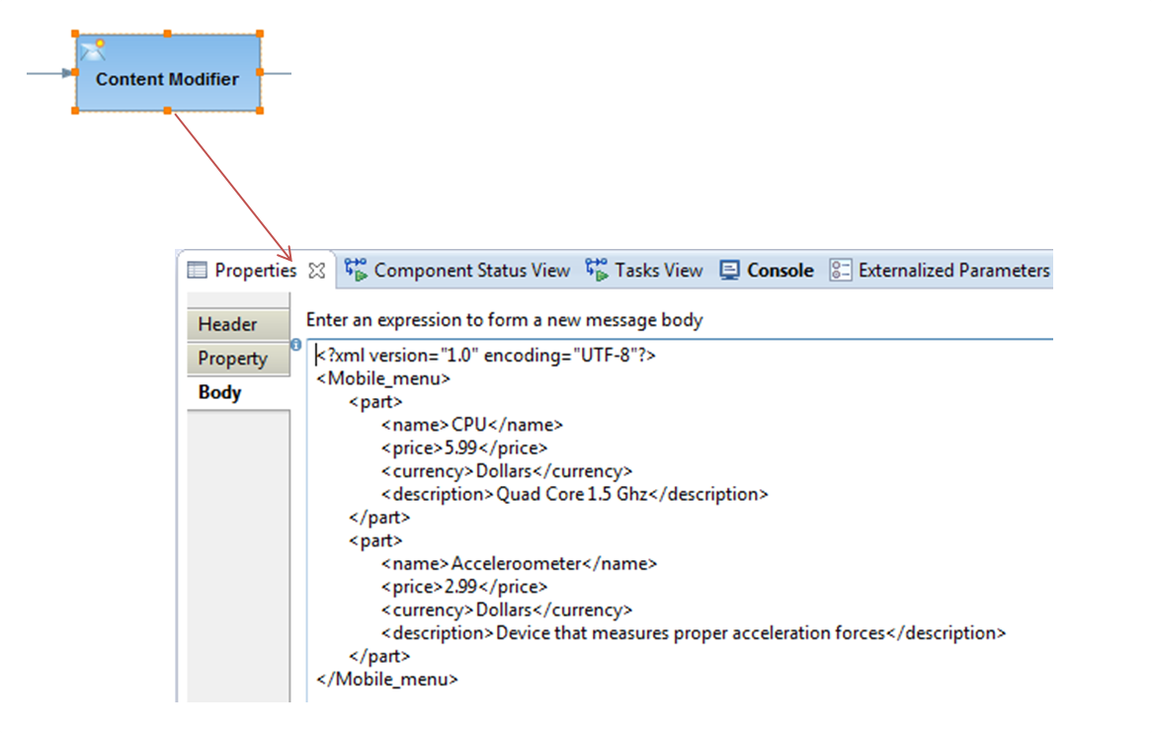
You can change between the two variants using the context menu of the multicast flow-step (for right-handers, it appears on right-click of the mouse).
An example Integration Flow
To understand the multicast pattern better, I shall take the example an Integration Flow and insert a Content Modifier step with a sample XML Payload in its body (shown below). In addition, I shall use a simple mapping step that converts the price and currency from Dollars to Euros.

Slide 30
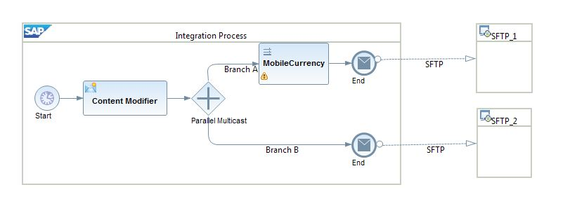
What ways can I use the Multicast pattern?
In Integration projects so far, we have seen its usage in the following two ways:
Use case 1: Send the message to multiple receivers. A simplified integration flow is shown below.

Slide 31
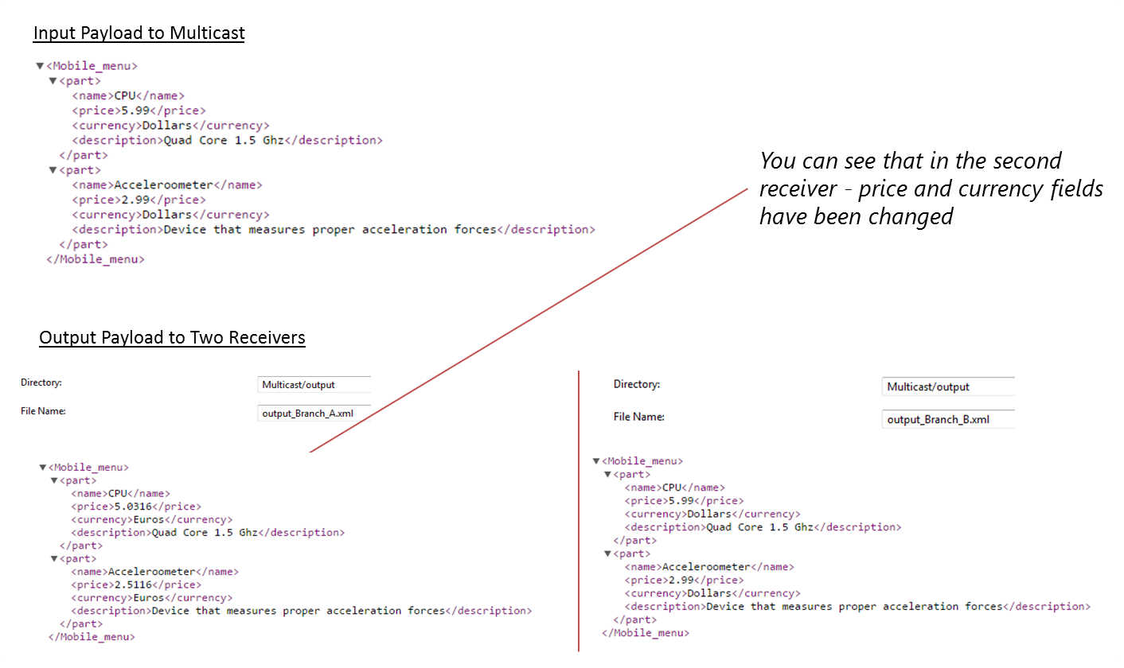
The input and output are demonstrated below. The input comes from the Content Modifier step. The first branch modifies the payload based on the mapping rules and the second one receive

Slide 32
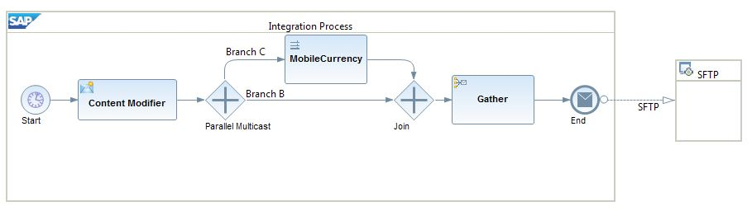
Use case 2: Multiple branches of the integration flow requires the same message contents
There are cases when you require the same message in different branches of the integration flow. This is a pattern also observed in the SuccessFactors scenario integration with 3rd party systems. In this case, you have to use the Join and Gather step. This shall collect all messages from different branches into one message.Example below:

Slide 33

Note: You have to use the Join + Gather step together. A Gather step alone shall not work.
Gather flowstep has quite a few options:

Slide 34
The Gather step enables you to merge messages from more than one route in an integration process. You define conditions based on the type of messages that you are gathering using the Gather step. You can choose to gather:
XML messages of different format
XML messages of the same format
Plain text messages
Based on this, you choose the strategy to combine the two messages:
XML messages of the same format, you can combine or specify the XPath to the node at which the messages have to be combined.
XML messages of different formats, you can only combine the messages
Plain text messages, you can only specify concatenation as the combine strategy

Slide 35
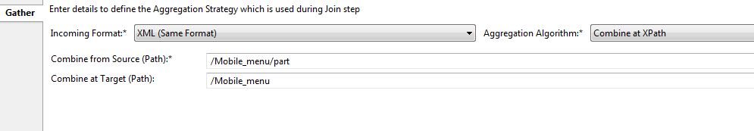
I take the example of XML messages of the same format. For the same payload that I described above, this is the option that I have chosen:

Slide 36
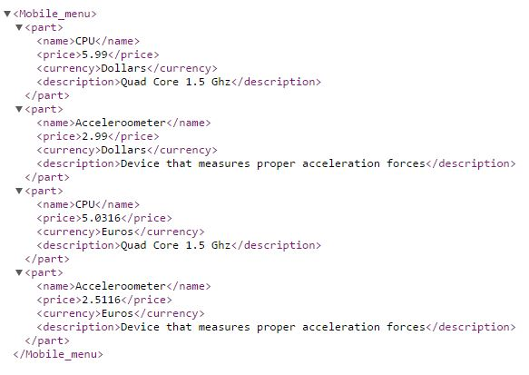
So, here I want to combine all the “<part>”nodes and group it under the main “Mobile_menu” node.
Understanding the aggregation strategy can get a little tricky. I would recommend playing around it with different values to get a hand on it.

Slide 37
What happens in case of Error?
The quality of service applied by default is “Stop on Exception”. In the Message Monitoring, it always shows as a Failed message. Few combinations exist:
If you have a Join+Gather step and one of the incoming branches (parallel or sequential) fails, then the processing is stopped.
When the multicast is connected to multiple receivers, then the successful branches shall receive the message correctly. However, the overall message in the monitoring shall still be shown as Failed.
In a sequential multicast, if a branch fails to execute a message – then the processing is stopped with an exception thrown.

Slide 38
Join and Gather
Define Gather and Join
The Gather step merges messages from different routes (into a single message) with the option to define certain strategies how to combine the initial messages
. The Join step is used in combination with the Gather step. It brings together the messages from different routes, but it does not affect the content of the messages.
Context
The Gather step allows you to define conditions based on the type of messages that are merged. You can choose to gather:
XML messages of different format
XML messages of the same format
Plain text messages
Any format

Slide 39
The Join element enables you to bring together messages from different routes before combining them into a single message. You use this step in combination with the Gather element. Join only brings together messages from different routes without affecting the content of messages.

Slide 40
Remember
If you want to combine messages that are transmitted to more than one route by a Multicast step, you need to place Join step before the Gather step.
If you want to combine messages that are split using a Splitter step, you use only the Gather step

Slide 41
Based on your requirements, you choose the strategy to combine the two messages:When combining XML messages of the same format, you have the following options:
Don't specify any condition (multimapping format).
Specify the XPath to the node at which the messages have to be combined.
For XML messages of different formats, you can only combine the messages.
For plain text messages, you can only specify concatenation as the combination strategy.
For all three incoming formats, you can also choose the strategy Zip that allows you to merge the input into a single archive (.zip) file. In that case, you need to specify a file name pattern

Slide 42
Procedure
To model a Gather step, in the palette, choose  (Message Routing), then Gather.
Place the Gather element in the integration process and define the message path.
On the General tab, you can change the name of the Gather element.
On the Aggregation Strategy tab, define the attributes of the element based on the descriptions in the following table.

Slide 43
Field | Description
Incoming Format | Specify format of incoming message. XML (Same Format) If messages from different routes are of the same format XML (Different Format) If messages from different routes are of the different format Plain Text If messages from different routes are of the plain text format Any If you want to combine any incoming messages independent of their format
Aggregation Algorithm | There are the following options: Combine (can only be selected if for Incoming Format you have selected XML (Same Format) or XML (Different Format)) Combine the incoming messages without any conditions. The messages are combined in Multimapping format.Note In case you are using the mapping step to map the output of this strategy, you can have the source XSD in the LHS and specify the Occurrence as 0..Unbounded. Combine at XPath (can only be selected if for Incoming Format you have selected XML (Same Format)) Combine the incoming messages at the specified XPath. Concatenate (can only be selected if for Incoming Format you have selected Plain Text) Concatenate the information from the different sources one after another Zip Aggregates files to an archive (.zip) file. Caution With this option, empty messages will not be included in the generated archive files. Tar Aggregates files to an archive (.tar) file. Caution With this option, empty messages will not be included in the generated archive files. Remember Any information that is in the header or property of a previous step is not aggregated by a Gather step.
Combine from source (XPath) (Enabled only if for Aggregation Algorithm the option Combine at XPath is selected) | XPath of the node that you are using as reference in the source message to retrieve the information.
Combine at target (XPath) (Enabled only if for Aggregation Algorithm the option Combine at XPath is selected) | XPath of node that acts as the root for combined message.
File Name (Enabled only if for Aggregation Algorithm the option Zip or Tar is selected) | Specify a simple expression to define unique file names within the archive. If not specified, header CamelFileName is evaluated. In case the header is not available at runtime, a unique file name will be generated

Slide 44
Define Router
Usage of Operators in Non-XML Conditions
Operator | Example
= | ${header.SenderId} = '1'
!= | ${header.SenderId} != '1'
> | ${header.SenderId} > '1'
>= | ${header.SenderId} >= '1'
< | ${header.SenderId} < '1'
<= | ${header.SenderId} <= '1'
and | ${header.SenderId}= '1' and ${header.ReceiverId} = '2'
or | ${header.SenderId}= '1' or ${header.ReceiverId}= '2'
contains | ${header.SenderId} contains '1'
not contains | ${header.SenderId} not contains '1'
in | ${header.SenderId} in '1,2'
not in | ${header.SenderId} not in '1,2'
regex | ${header.SenderId} regex '1.*'
not regex | ${header.SenderId} not regex '1.*'
Context
You perform this task when you have to specify conditions based on which the messages are routed to a receiver or an interface during runtime. If the message contains XML payload, you form expressions using the XPath-supported operators. If the message contains non-XML payload, you form expressions using the operators shown in the table below:

Slide 45
You can define a condition based on property or exception that may occur.
If the condition ${property.SenderId} = '1' is true, then Router routes the message to a particular sender whose Sender ID is 1.
If the condition ${exception.message}contains 'java.lang.Exception' is true, then Router routes the message to a particular receiver, otherwise it routes to another receiver.

Slide 46
Procedure
In the palette, choose  (Message Routing), then Router.
Place the Router element in the integration process and define the message path.
Select either Router or the routing branch (Route) splitting from the router.
If you select Router, then execute the following steps:
On the General tab, you can change the name of the Router element.
On the Processing tab, select Throw Exception to respond to an error occurence.You can also use Error End Event to raise an exception.
In the Routing Condition table, select the default route.If you select Throw Exception, the default route must terminate with Terminate Message.
If you select Route, then execute the following steps.
On the General tab, you can change the name of the route.
On the Processing tab, from the Expression Type dropdown, select the type of expression used to formulate the routing condition.
Select XML to form an expression using XPath or select Non-XML to form an expression using message header, property, or exception.
In the Condition field, formulate a valid XML or non-XML condition that routes the message to its associated receiver.

Slide 47
If you want to set the selected route as the default, so that its associated receiver handles the error situation if no receiver is found, select the Default Route option.

Slide 48
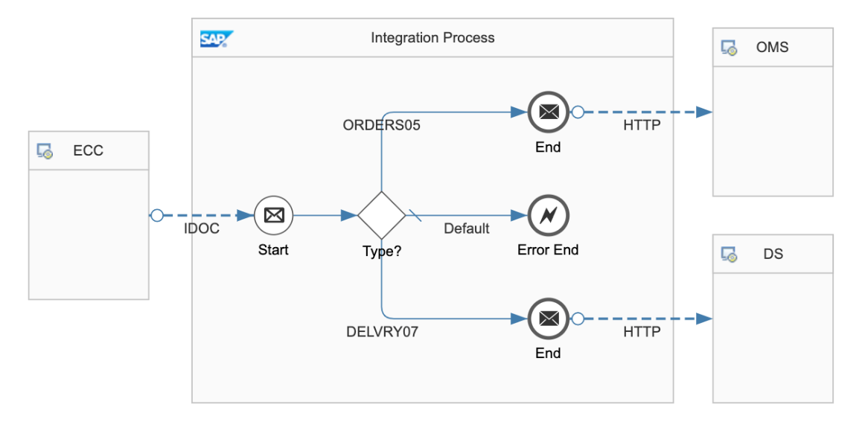

Slide 49
QnA

Slide 50
Thank You

Slide 51
SAP Cloud Integration
Training
ON THE
SAP BUSINESS TECHNOLOGY PLATFORM
Date: Dec 11th, 2022
Time: 8:00PM IST
Facilitator: Anu
www.anubhavtrainings.com

Slide 52
Agenda
Mapping
Converter
CSV to XML converter
Live example of postman to CPI using CSV to XMLconverter

Slide 53
Adapters
Connects SAP Cloud Integration to Sender or Receiver
HTTPS:
Establishes an HTTPS connection between SAP Cloud Integration and a sender system.

Slide 54
HTTP ADAPTER
Parameters of the HTTPS Sender Adapter
Parameter | Description
Address | Enter the URL of the HTTP system to connect to.
Authorization | Specifies the authorization option for the sender.
CSRF Protected | This option prevents Cross-Site Request Forgery (CSRF), which is a malicious online attack. Such attacks exposes user content without their authorization.
CamelHttpUrl
Refers to the complete URL called, without query parameters.
For example, CamelHttpUrl=https://test.bsn.neo.ondemand.com/http/hello.

Slide 55
Postman CPI Integration
Postman
CPI

Slide 56
POSTMAN CPI integration
Things required
End point URL
CPI User id and password

Slide 57
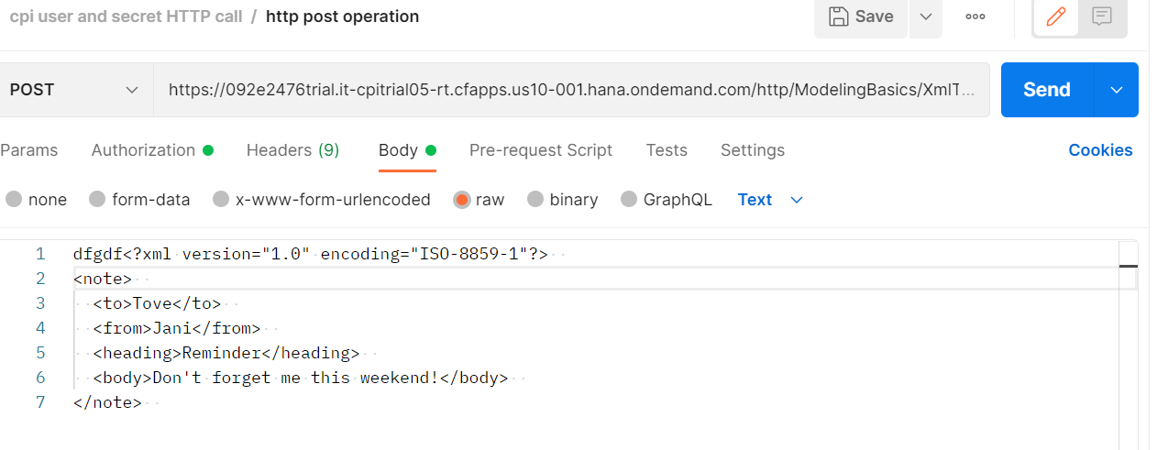
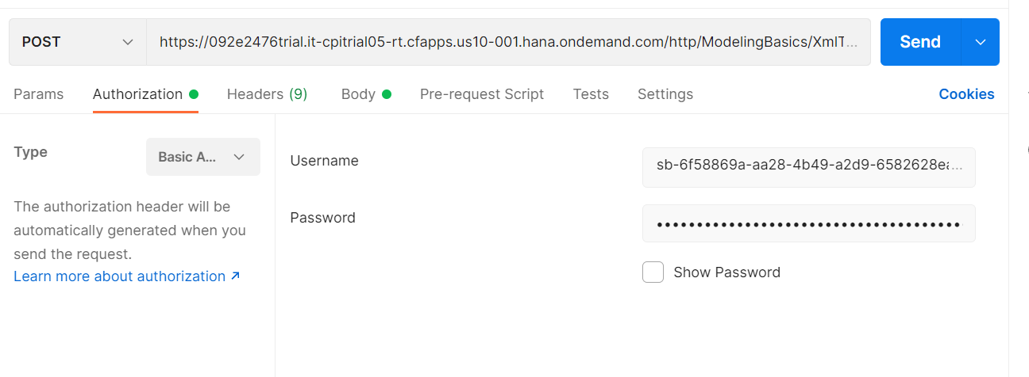
POSTMAN CPI INtegration

Slide 58
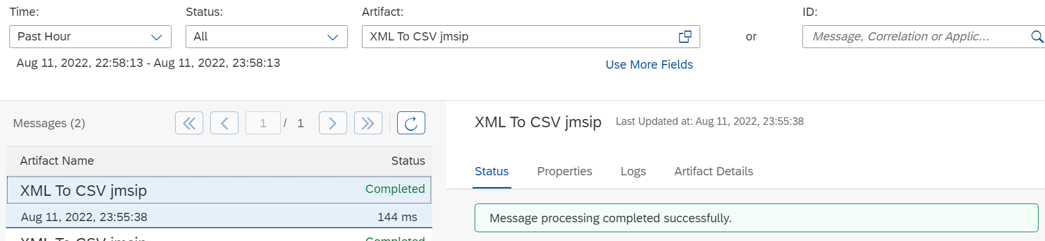
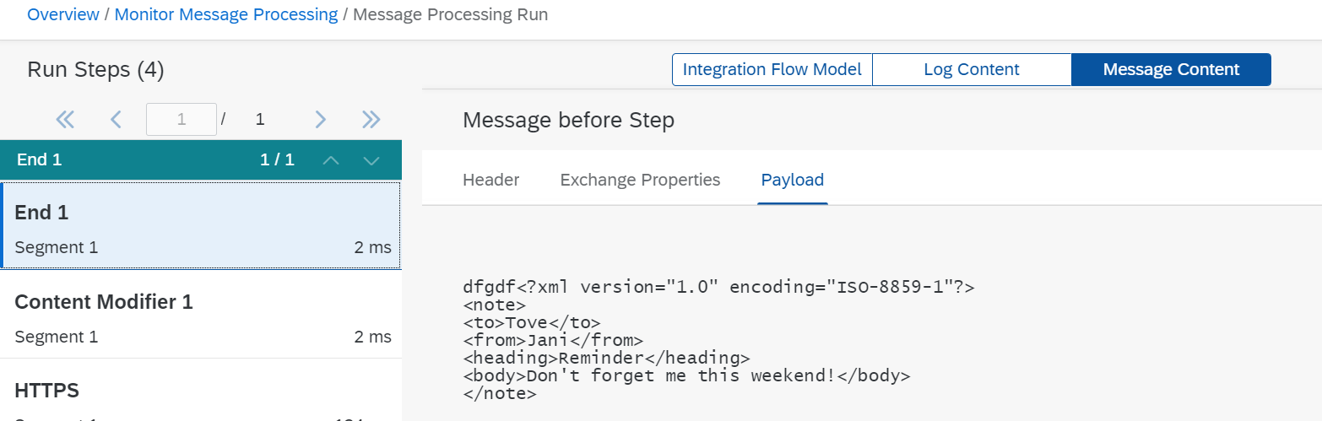
POSTMAN CPI INtegration

Slide 59
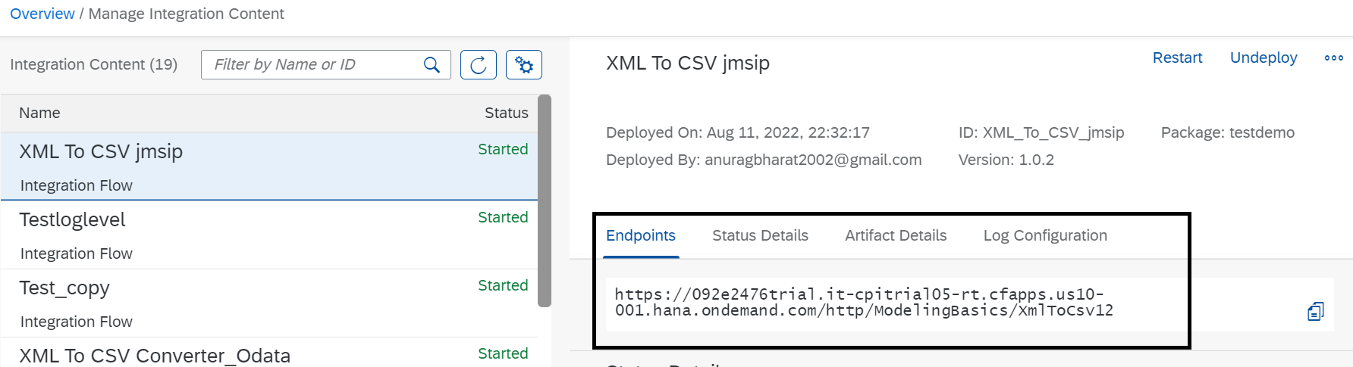
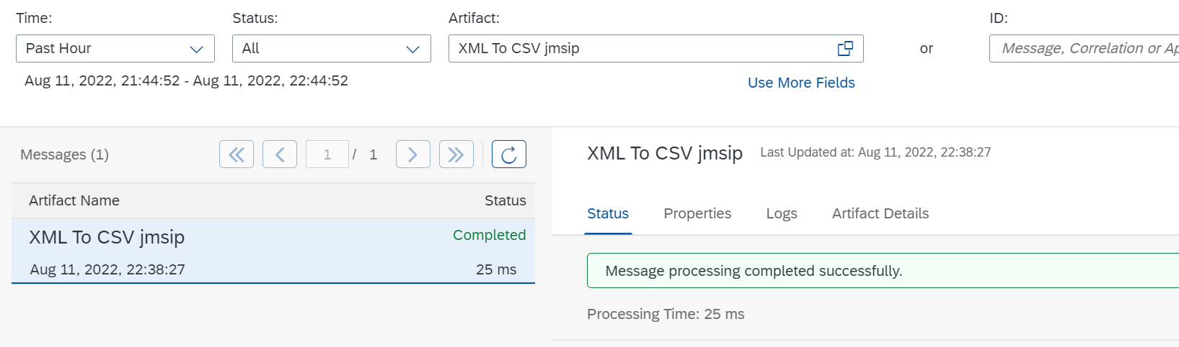
POSTMAN CPI Integration

Slide 60
CSV to XML Converter
Procedure
In the palette, choose , then navigate to Converter CSV to XML Converter.
Place the CSV to XML converter shape in the integration process and define the message path.

Slide 61
Choose CSV to XML Converter and provide values in fields based on description in table.

Slide 62
Field | Description
XML Schema | Choose Browse. Select the XML schema you want to use. Optionally, you can also upload the XML schema from your local file system by choosing Upload from File System.
Path to Target Element in XSD | XPath in the XML schema file where you want to place the content from CSV file.
Record Marker in CSV | The record in CSV file that indicates the entry that the converter has to consider as the starting point of the content. Note If you don’t provide a value for this field, the converter considers all the records in the CSV file for conversion.
Field Separator in CSV | Select the character from dropdown list that is used as the field separator in CSV file. Tip If you want to use a field separator that isn’t available in the dropdown list, manually enter the character.
Exclude First Line Header | Select this checkbox if you want to use the header information from the first line of CSV file to map the column to the corresponding xsd attributes.Note If you don't select the checkbox, then the converter maps the attributes of the CSV file to the order of occurrence in the XSD. To use this option, the CSV and XSD must share the same header-attribute names. If the header names don't match or the same header name is used multiple times in the first line of the CSV, it leads to ambiguity that the converter can resolve as it's an unsupported XML specification.
Choose CSV to XML Converter and provide values in fields based on description in table

Slide 64
Schema
<?xml version="1.0" encoding="UTF-8" standalone="yes"?><xs:schema attributeFormDefault="unqualified" elementFormDefault="qualified" xmlns:xs="http://www.w3.org/2001/XMLSchema"> <xs:element name="Products"> <xs:complexType> <xs:sequence> <xs:element minOccurs="1" maxOccurs="unbounded" name="Product"> <xs:complexType> <xs:sequence> <xs:element nillable="false" maxOccurs="1" name="ProductId"> <xs:simpleType> <xs:restriction base="xs:string" xmlns=""> <xs:maxLength value="10"/> </xs:restriction> </xs:simpleType> </xs:element> <xs:element type="xs:string" nillable="true" minOccurs="0" maxOccurs="1" name="Name" xmlns=""/> <xs:element nillable="true" minOccurs="0" maxOccurs="1" name="Category"> <xs:simpleType> <xs:restriction base="xs:string" xmlns=""> <xs:maxLength value="40"/> </xs:restriction> </xs:simpleType> </xs:element> <xs:element nillable="true" minOccurs="0" maxOccurs="1" name="DimensionUnit"> <xs:simpleType> <xs:restriction base="xs:string" xmlns=""> <xs:maxLength value="3"/> </xs:restriction> </xs:simpleType> </xs:element> <xs:element type="xs:decimal" nillable="true" minOccurs="0" maxOccurs="1" name="DimensionDepth" xmlns=""/> <xs:element type="xs:decimal" nillable="true" minOccurs="0" maxOccurs="1" name="DimensionHeight" xmlns=""/> <xs:element type="xs:decimal" nillable="true" minOccurs="0" maxOccurs="1" name="DimensionWidth" xmlns=""/> <xs:element type="xs:decimal" nillable="true" minOccurs="0" maxOccurs="1" name="Weight" xmlns=""/> <xs:element nillable="true" minOccurs="0" maxOccurs="1" name="WeightUnit"> <xs:simpleType> <xs:restriction base="xs:string" xmlns=""> <xs:maxLength value="3"/> </xs:restriction> </xs:simpleType> </xs:element> </xs:sequence> </xs:complexType> </xs:element> </xs:sequence> </xs:complexType> </xs:element></xs:schema>

Slide 68
XML to CSV Converter
Procedure
In the palette, choose , then Converter XML to CSV Converter.
Place the XML to CSV converter in the integration process and define the message path.

Slide 69
Field | Description
Path to Source Element in XSD | Path to the source element in the XSD file
Field Separator in CSV | Select the character that you want to use as the field separator in CSV file from dropdown list Tip If you want to use a field separator that is not available in the dropdown list, manually enter the character.
Include Field Name as Headers | Select this checkbox if you want to use the field names as the headers in CSV file
Include Parent Element | Select this checkbox if you want to include the parent element of the XML file in CSV file
Include Attribute Values | Select this checkbox if you want to include attribute values in the CSV file
Choose XML to CSV Converter and provide values in fields based on description in table

Slide 70
Json to XML converter
The JSON to XML converter enables you to transform messages in JSON format to XML format.
Procedure
In the palette, choose , then choose Transformation Converter JSON to XML Converter.
Insert the converter at the desired position in your integration process. The converter appears as a graphical element in your integration process.
The properties tab page for the XML to JSON Converter opens.

Slide 71
Json to XML converter
Tab | Option | Description
General | Name | Enter the name of the converter.
Processing | JSON Prefix (only if the option Use Namespace Mapping is selected) | Enter the mapping of the JSON prefix to the XML namespace. The JSON namespace/prefix must begin with a letter and can contain aA-zZ and 0-9.
 | JSON Prefix Separator | Enter the JSON prefix separator to be used to separate the JSON prefix from the local part. The value used must not be used in the JSON prefix or local name. The following characters are allowed: colon(:), comma(,), dot(.), pipe(|), semicolon(;), and space.
 | Add XML Root Element | Select this option to convert JSON documents with an XML root element
 | Name (only if the option Add XML Root Element is selected) | Enter the name of the XML root element. The name must comply with the NCName rules: The name must begin with a letter or an underscore. The valid characters for the remainder of the name are: Letters Digits Period Hyphen Underscore
 | Namespace Mapping (only if the option Add XML Root Element is selected) | Enter the namespace of the XML root element that you have configured in the integration flow.
Define the parameters for your conversion, see table below

Slide 72
XML to JSON Converter
Procedure
In the palette, choose  Transformation Converter XML to JSON Converter.Your cusor symbol
Insert the converter at the desired position in your integration process.The converter appears as a graphical element in your integration process.
The properties tab page for the XML to JSON-Converter opens

Slide 73
Option | Description
Name | Enter the name of the converter.
JSON Output Encoding | Enter the JSON output encoding. The default value is from header or property. If you select from header or property, the converter tries to read the encoding from the message header or exchange property CamelCharsetName. If there is no value defined, UTF-8 is used.
XML Namespace (only if the option Namespace Mapping is selected) | If you select from header or property, the converter tries to read the encoding from the message header or exchange property CamelCharsetName. If there is no value defined, UTF-8 is used.
JSON Prefix Separator (only if the option Namespace Mapping is selected) | Enter the JSON prefix separator to be used to separate the JSON prefix from the local part. The value used must not be used in the JSON prefix or local name. The following characters are allowed: colon(:), comma(,), dot(.), pipe(|), semicolon(;), and space.
Suppress JSON Root Element | Choose this option to create the JSON message without the root element tag.
Define the parameters for your conversion, see table below

Slide 74
Message Mapping
Message Mapping is nothing but a set of rules for producing target XML from the source XML.
These rules are nothing but relations between the source XML tags and target XML tags”
For example, consider the record Employee and we need to update the employee identification number. In the sender system, the field name is Employee ID. However, in the receiver system, the same field is called ID.

Slide 75
Source Field | Target Field
Employee | User
Employee ID | ID
Employee Name | Name
Employee Surname | LastName
Date of Birth | DOB

Slide 76
Use
You use message mapping, to define an association between fields of messages with different structuring. This enables the Cloud Integration system to recognize and update the relevant fields in the target systems.

Slide 78
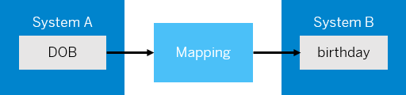
Standard and Custom Mapping Functions
In the same scenario, let us assume that the date of birth in system A is in YYYY-MM-DD format. You want to change the format to DD-MM-YYYY, the format in system B. In this case, you can use a mapping function that transforms the data into the format that you want, which in this case is DD-MM-YYYY.

Slide 79
The mapping editor provides some standard functions like Arithmetic, Boolean, Constants, Conversions, and Date.
If you're unable to achieve the desired transformation using standard functions, you can create a custom function in one of the following ways.Choose  (create script) to create a custom-mapping function by manually entering the script.
Choose  (add script file) to upload a script file that contains the custom-mapping function.

Slide 80
Testing Message Mapping
The mapping editor provides 2 ways of testing message mapping:Simulate – for testing the entire mapping XML.
Display Queue – for testing a specific node of the XML.

Slide 86
Q n A

Slide 87
Thank You

